Slide 1

Git: The Powerful Version Control System
Balaji B Associate software developer, IQVIA

Slide 2

What is Git?
Git is a free and open-source distributed version control system designed to handle everything from small to very large projects with speed and efficiency. It is the world's most popular "Version Control System - VCS", with over 95% of VCS users relying on Git. Git is used by developers, designers, scientists, writers, PhD scholars, and even governments to manage project sizes, maintain different versions, and collaborate on changes as a team.

Slide 3

Key Benefits of Git
1
Travel Back in Time
2
Collaborative Workflow
3
Merge Changes Effortlessly
Git allows you to easily revert to older versions of your project, making it a powerful tool for managing changes and experimenting with new ideas.
Git enables seamless collaboration and sharing of changes among team members, making it an essential tool for distributed and remote work.
Git's merge capabilities make it easy to combine different branches of development, even when there are conflicting changes, allowing for a smooth integration of new features and bug fixes.

Slide 4

Getting Started with Git
1
Installation
Git is primarily a terminal-based tool, but there are also graphical user interfaces (GUIs) available to help users who are not command line experts. On macOS, Git is often pre-installed, but you can also install it using a package manager like Homebrew.
2
Configuration
Before you start using Git, it's important to configure your username and email address, which will be associated with your commits. This information helps track the changes made by different contributors in a project.
3
Basics: Adding and Committing
The first step in using Git is to create a repository, which is a workspace that tracks and manages files within a folder. You can then add files to the staging area and commit them to the local repository, creating a version history that can be easily referenced and shared.

Slide 5
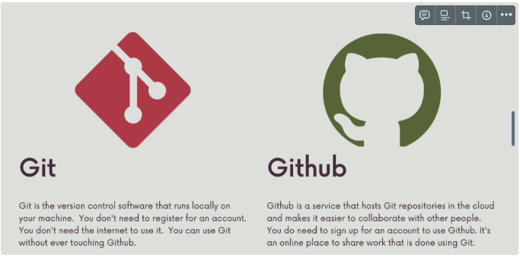

Slide 6
Branching and Merging
Branches
Merging
Branching Strategies
Branches are a fundamental concept in Git, allowing you to create separate lines of development within a project. The default branch is typically called "master" or "main", and it represents the main source of truth for the project.
Merging is the process of combining changes from one branch into another. Git offers several types of merges, including fast-forward merges, merge commits, and merge conflicts.
Depending on the size and complexity of your project, you may want to adopt a specific branching strategy, such as the popular Git Flow or GitHub Flow. These strategies provide a structured approach to managing branches and releases.
Resolving merge conflicts can be a bit tricky, but Git provides tools and guidance to help you navigate these situations and ensure a smooth integration of changes.
You can create new branches to work on specific features or bug fixes, and then merge them back into the main branch when the work is complete.

Slide 7




Advanced Git Concepts
Diff and Comparison
Git's diff command allows you to compare changes between different commits, branches, or the working directory. This is a powerful tool for understanding the evolution of your project and identifying specific changes.
Stashing
Stashing is a way to temporarily save your local changes without committing them. This is useful when you need to switch to a different branch but don't want to lose your current work.
Amending Commits
If you need to make a small change to your most recent commit, you can use the "amend" command to update the commit message or include additional changes without creating a new commit.

Slide 8




Git Tooling and Interfaces
Command Line
GUI Tools
IDE Integration
Remote Hosting
While Git is primarily a command-line tool, there are also graphical user interface (GUI) tools like GitKraken that provide a more visual and user-friendly way to interact with Git.
Git is primarily a command-line tool, and understanding terminal commands is essential for working with it effectively.
Many popular code editors, such as Visual Studio Code, have built-in Git integration, allowing you to manage your version control directly within the development environment.
Services like GitHub, GitLab, and Bitbucket provide remote hosting for your Git repositories, enabling collaboration, issue tracking, and other project management features.

Slide 9
Git in the Real World
Developers
Designers
Git is an essential tool for software developers, allowing them to manage code changes, collaborate with team members, and track the evolution of their projects.
Designers can use Git to version control their design files, such as Photoshop, Sketch, or Figma documents, enabling them to revert changes, experiment with new ideas, and collaborate with developers.
Writers and Researchers
Government and Enterprise
Git is not just for code; it can also be used by writers, researchers, and academics to manage their text-based documents, such as articles, papers, and books, ensuring version control and collaboration.
Governments and large organizations are increasingly adopting Git to manage their information and policies, taking advantage of its version control, collaboration, and transparency features.

Slide 10
Git: The Foundation of Modern Development
Free and Open-Source
Git is a free and open-source distributed version control system, making it accessible to developers and teams of all sizes.
Distributed Architecture
Git's distributed nature allows for offline work, local branching, and merging, providing a flexible and efficient workflow.
Powerful Branching
Git's branching capabilities enable developers to experiment, collaborate, and manage complex projects with ease.
Scalable and Performant
Git is designed to handle projects of all sizes, from small personal projects to large-scale enterprise applications, with speed and efficiency.
Widespread Adoption
With over 95% of version control system users relying on Git, it has become the de facto standard for modern software development.

Slide 11

Conclusion: Mastering Git, Mastering Development
Git has become an essential tool in the world of software development, enabling developers, designers, and professionals across various industries to effectively manage their projects, collaborate with team members, and maintain a robust version control system. By understanding the fundamentals of Git, including branching, merging, and advanced concepts, you can unlock the full potential of this powerful version control system and become a more efficient and productive professional in your field.

